Slide 1
Lower Sutter Bypass Anadromous Fish Habitat Management Planning Project
Workshop 5: Alternatives and Conceptual Plan
November 15, 2021

Slide 2
Agenda
Welcome, Workshop Objective
Project Update and Objectives
Existing Conditions – Outcomes from Previous Workshops
Alternatives Identified to Date
Discussion
Next Steps

Slide 3
Workshop Objective
Solicit input on conceptual fish habitat management plan alternatives for the Lower Sutter Bypass.

Slide 4
Project Update and Objectives

Slide 5
Project Activity
Workshop #1
Held January 2021
Project Launch (Roles & Processes)
Core Working Group Meeting #1
Held March 2021
Core Working Group role
Workshop #2-Fish Ecology
Held March 2021
Summary of fish studies, reviewed lessons learned from other planning processes (Fremont Big Notch)
Visions for the project
Reviewed Draft Charter and Stakeholder Engagement Plan
Existing conditions for fish (variability in hydrology)
Framework for evaluating salmon habitat

Slide 6
Project Activity
Project Team Meeting: CDFW Information Sharing
Held April 2021
Butte Creek spring run salmon restoration
Core Working Group Meeting #2
Held April 2021
Workshop #3- Agricultural Production
Held May 2021
Summarized farming in the bypass and associated challenges
Available data sets
Reviewed Structured Decision Making (SDM) process
Suggested habitat project objectives
Provided a list of draft fundamental and mean objectives for CWG feedback
Planning for Workshop #3 (Ag Production)
Discussed conditions to make farming in the bypass a better endeavor
Explored types of actions to improve fish habitat and potential impacts on ag

Slide 7
Project Activity
Core Working Group Meeting #3
Held June 2021
Continued revising fundamental and means objectives
Workshop #4- Flood Management
Held June 2021
Core Working Group Meeting #4
Held August 2021
Shared Sub-team meeting updates
Reviewed flood management in the bypass and Feather River corridor (perspectives from DWR, Reclamation Districts, and CVFPB)
Reviewed Technical Team’s modeling approach and tools
Reviewed work plan and conceptual plan sections
Discussed initial conceptual alternatives for Dos Rios, Goose Club, and Nelson Slough
Planning for Workshop #4 (Flood Management)
Identified need for fish and ag sub-team meetings

Slide 8
Project Activity
Core Working Group Meeting #5
Held October 2021
Shared Sub-team meeting updates
Workshop #5- Alternatives & Conceptual Plan
November 2021
Reviewed objectives and proposed metrics
Discussed conceptual alternatives, plan development, and remaining project timeline

Slide 9
Fundamental Objective
Increase the ecological functions of the Lower Sutter Bypass to benefit anadromous fishes and other species of conservation concern while maintaining agricultural viability and flood conveyance.

Slide 10
Means Objectives
Increase hydrologic connectivity between the Lower Sutter Bypass and the Sacramento and Feather rivers and lower Butte Creek to provide access onto and off-of the floodplain for juvenile salmon.
Increase the frequency and duration of inundation of the Lower Sutter Bypass to stimulate production of zooplankton and other invertebrates to provide habitats for rearing when juvenile salmon are migrating through in the area.
Increase habitat diversity (i.e. riparian vegetation) on the floodplains of the Lower Sutter Bypass during varying flow conditions.
Improve juvenile migration, movement and access to functional habitat.
Reduce impediments to adult fish passage.
Maintain agricultural viability
Maintain flood conveyance

Slide 11
Existing Conditions

Slide 12
Alternatives Identified to Date

Slide 13
Programs that are needed:
1. Aquatic Invasives Removal and Treatment
Should include:
identification of exacerbating factors and prioritize corrections
(for example rock structures in Butte Creek)
Matching regulatory conditions with Division of Boating and Waterways: Monitoring, chemical/mechanical, reporting
Between $100,000 and $350,000 per year
Geographic extent that includes all of Sutter Bypass including Tisdale
This habitat management plan will include options for management and cost estimates for such program.

Slide 14
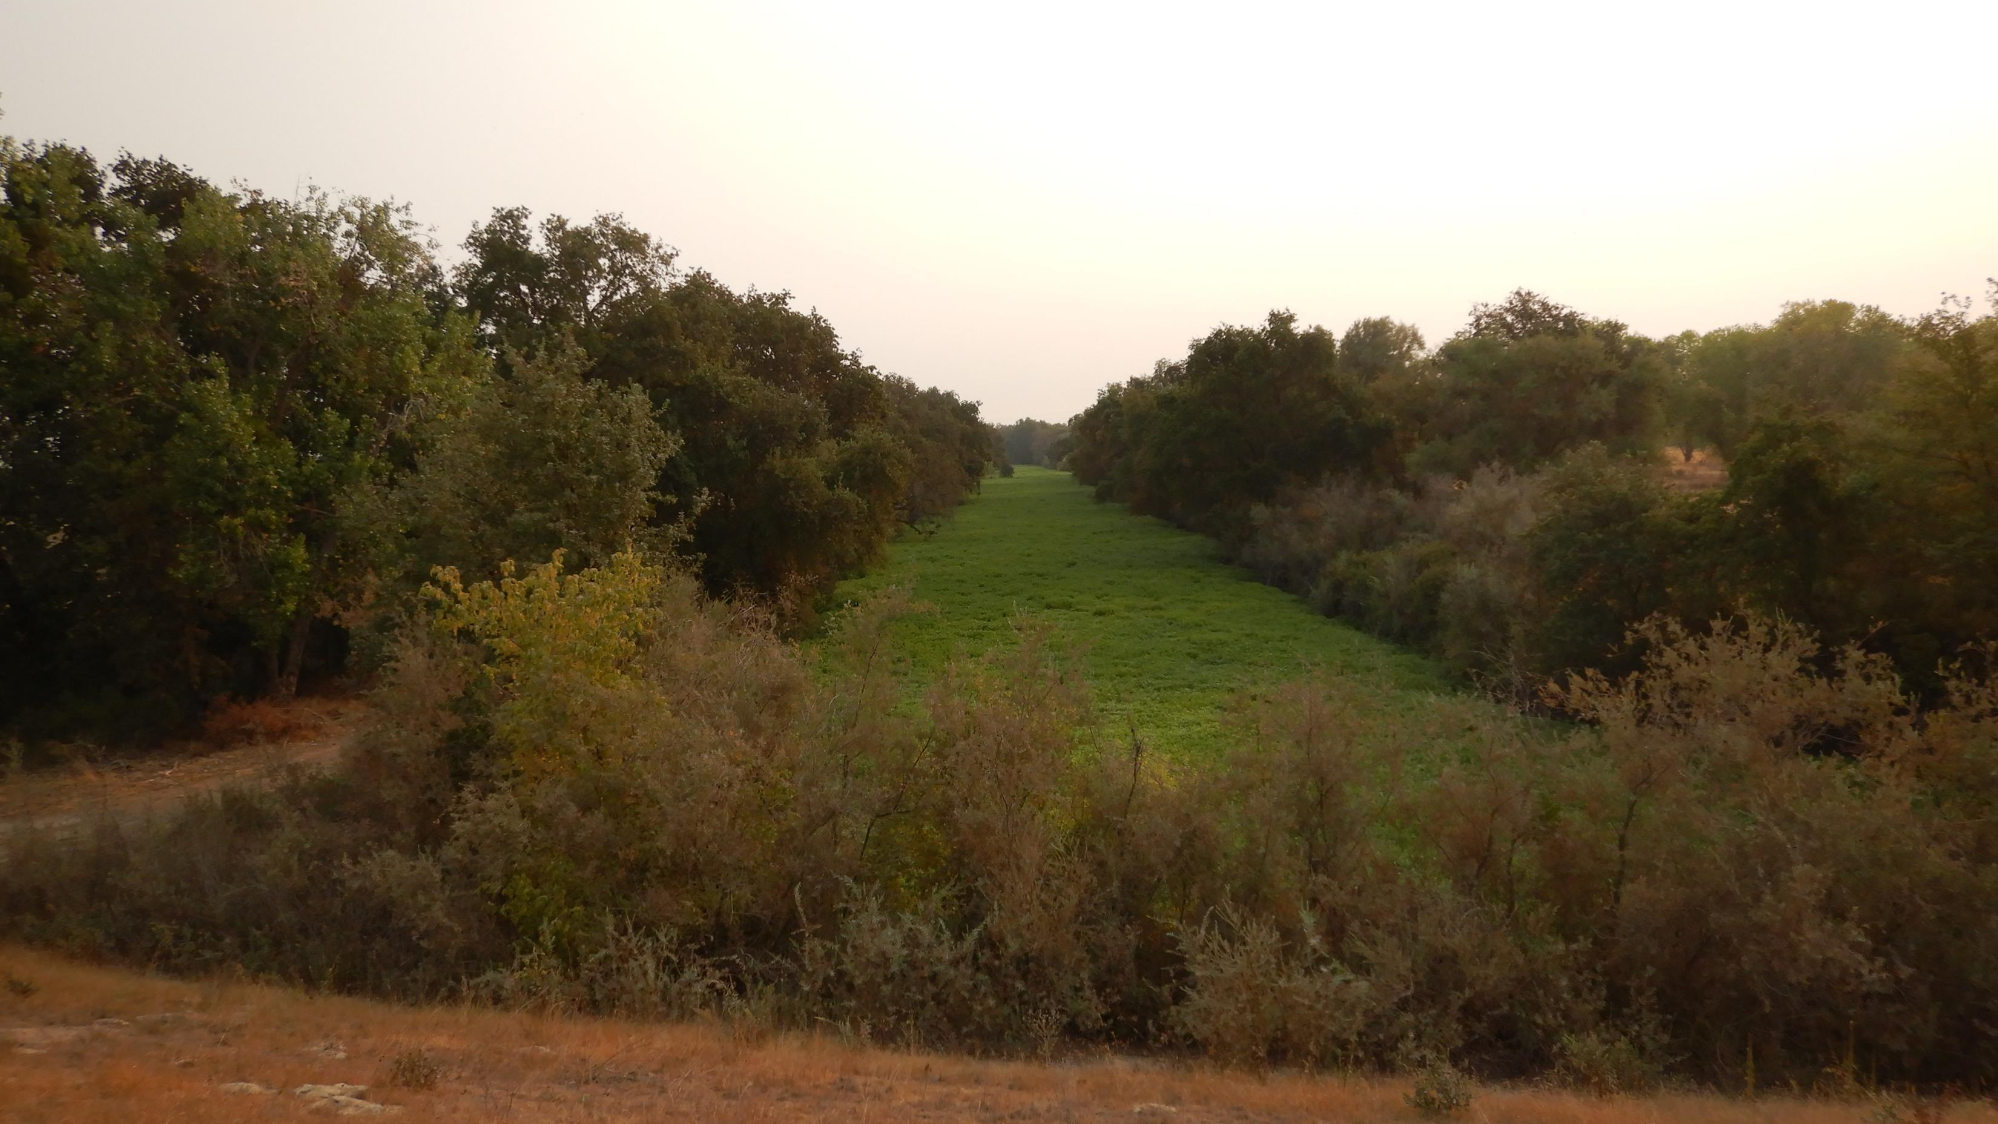

Slide 15
Programs that are needed:
2. Priority Fish Passage Barrier Removal
Should include:
Identification and prioritization of passage barriers throughout all of Sutter Bypass
Using existing protocols from CV fish barrier removal programs
Partial barriers that contribute to poor passage conditions, such as accumulating aquatic invasives
Target high priority removals for capital investment ASAP
This habitat management plan will provide a list of existing barriers and conditions of prioritizing for only Lower Sutter Bypass.

Slide 16
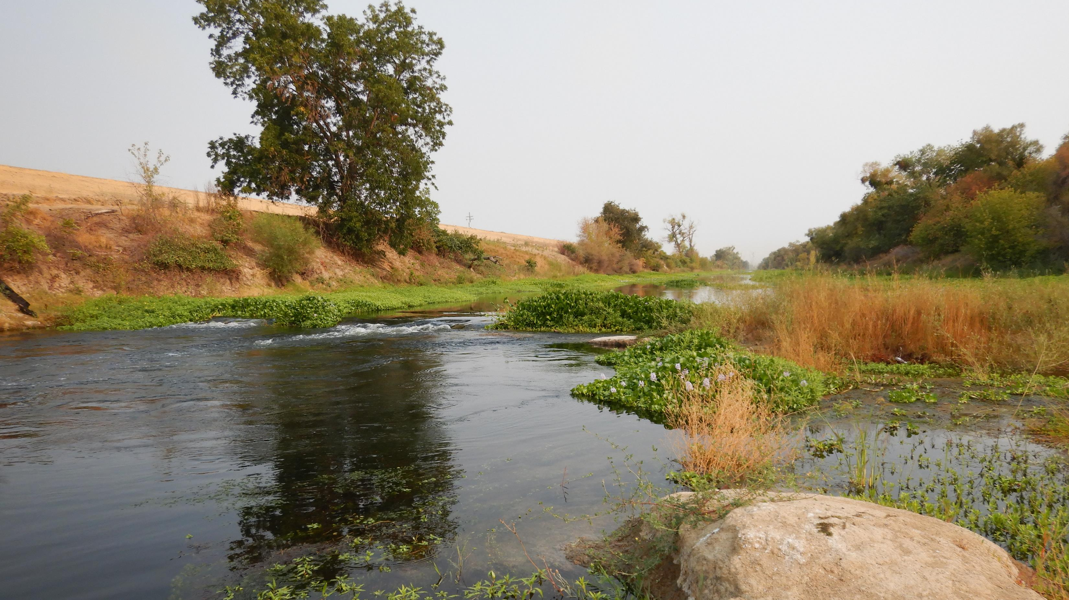

Slide 17
Programs that are needed:
3. Gauging and Monitoring
Should include:
New gauges needed and action plan to install
Continued engagement with and support for broader participation in Sutter Bypass Science collaboratives
Specific fish monitoring for new habitat features and/or land management changes
This habitat management plan will provide a list of stakeholders’ ideas of new data needs.

Slide 19
Programs that are needed:
4. Sediment Removal Program
Should include:
Identification of existing permit holders, conditions, and constraints
Prioritization of locations and targets for ambient sediment removal
Post-event monitoring for large floods
Cost evaluation including benefits to conveyance and habitat
This habitat management plan will provide an overview of existing sediment removal program at Goose Club and potential/challenges to expand the program to support habitat goals.

Slide 21
Programs that are needed:
5. Rice Field Rearing Pilot
Under development with agencies and stakeholders

Slide 22
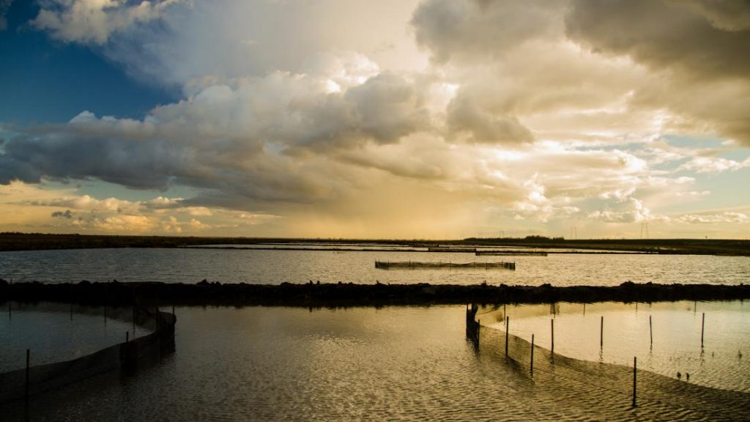

Slide 23
Feather River Connection Alternatives
Connection through Feather River side channel
Connection north of the Nelson Bend Control Structure
Controlled access on Goose Club at former breach locations

Slide 24
Increased Connectivity from West Borrow Canal
Passive Connection: degrade berm to increase volitional passage
Controlled Drainage: design and install control structures to give more flexibility and allow for agricultural production

Slide 25
Discussion

Slide 26
Next Steps

Slide 27
Project Timeline
Core Working Group Meeting #6
December 2021
Core Working Group Meeting #7
February 2022
Finalize Conceptual Plan
Refinement of conceptual project alternatives
*Will be rescheduling information sessions

Slide 28
Extra Slides for Reference?

Slide 29
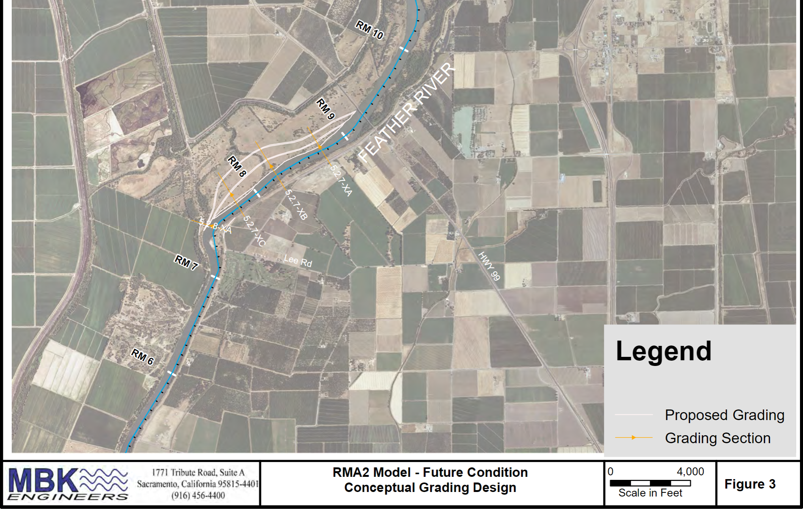
Nelson Slough Wildlife Area
Floodplain Bench Grading
Proposed in FRCMP
Not a preferred approach in 2021
due to:
Land tenure
Expense
Durability (sediment dynamics)

Slide 30
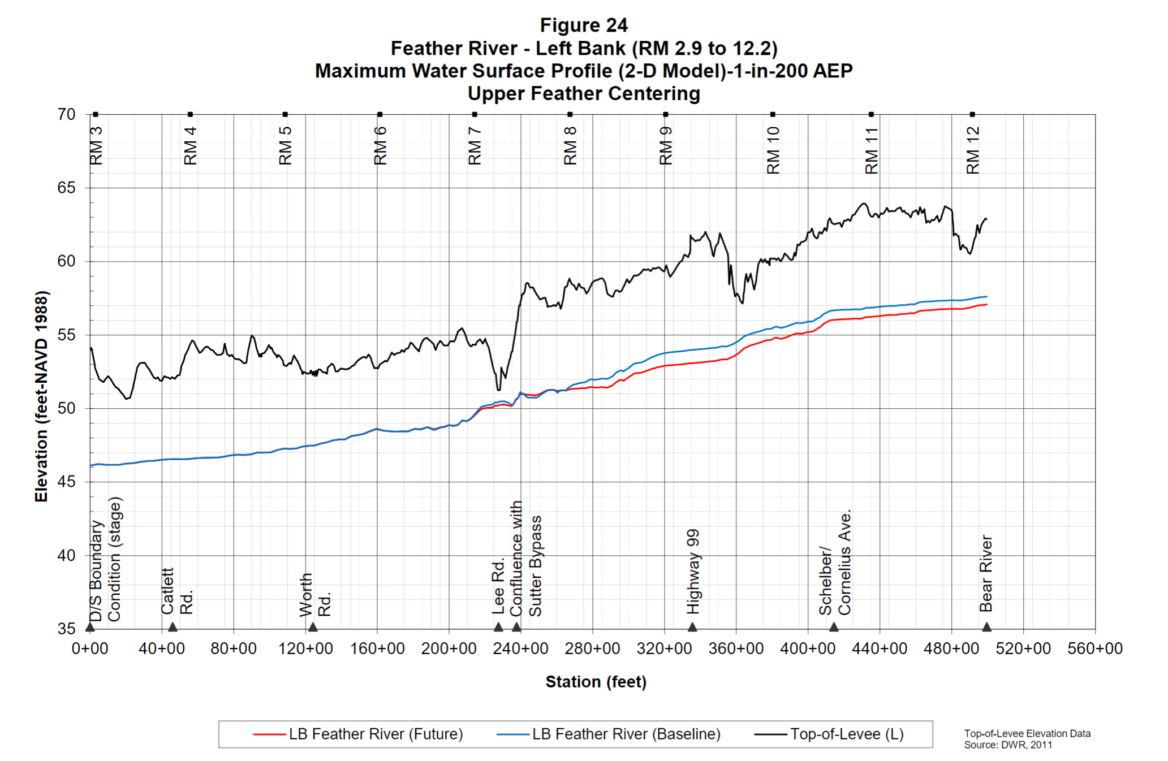
Freeboard in the Project Area
For a 1-in-200 AEP:
Levee freeboard typically ranges from 4 to 8’
Top-of-Levee drops at confluence

Slide 31
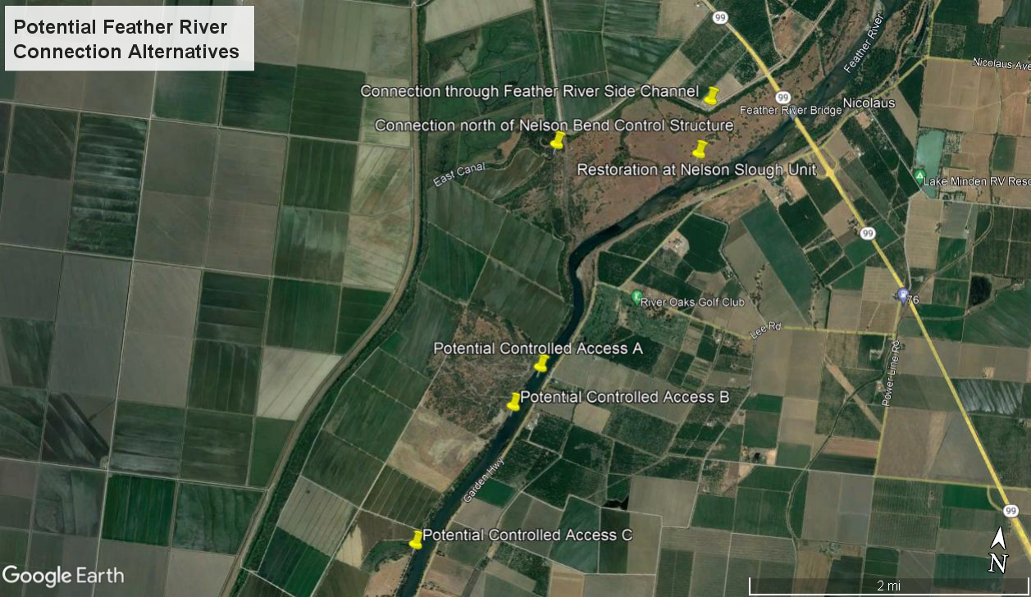

Slide 32
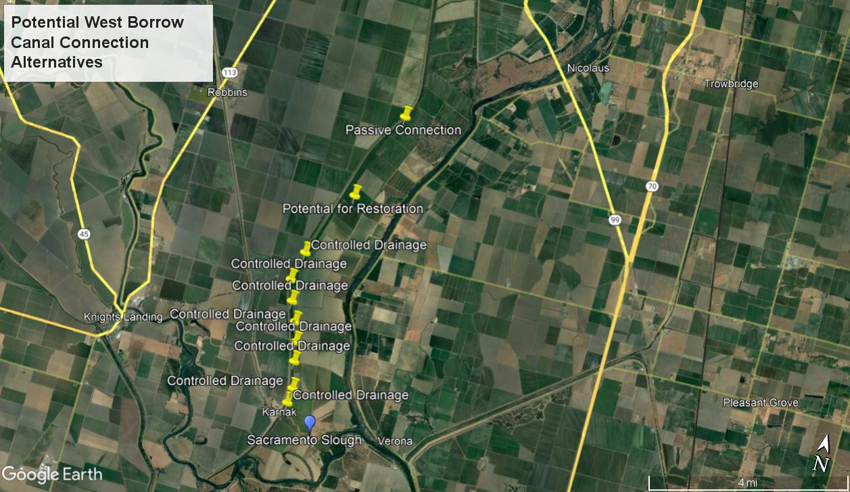

Slide 33
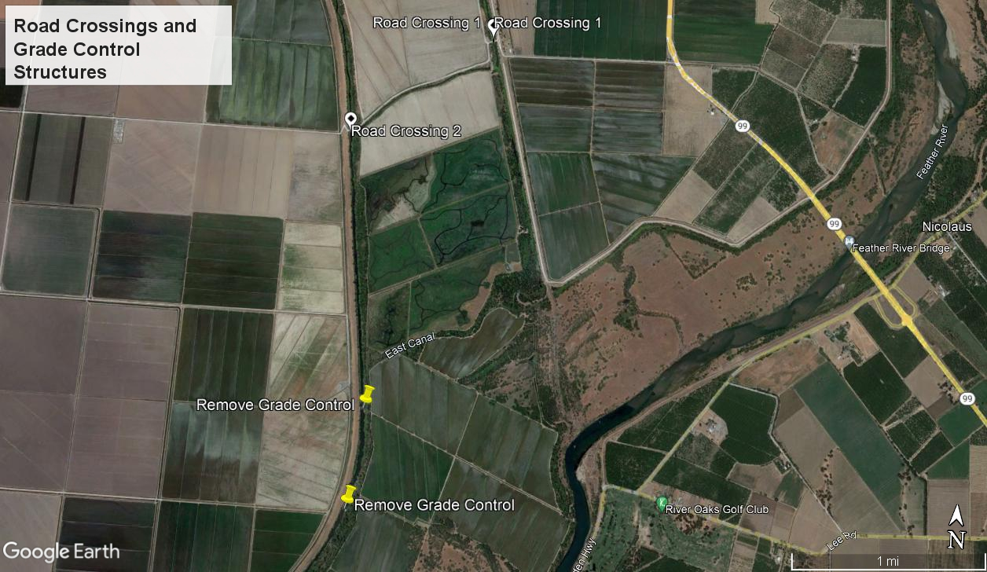

Slide 34
